Slide 1



Testing and software development life cycle(SDLC)

Slide 2
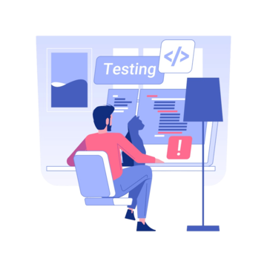
What is testing
The testing is a process of identifying the bugs, errors or the defects in the software or the code. It is used to check that the project or the product is satisfying the requirement of the client or the end user.
Objectives of testing
Ensuring the quality of the project/product/software
To find the problems and mistakes or issues before it causes any trouble
Making sure it's easy to understand and easy to use
Ensuring the correct ness in the project or the product
Ensuring the safety and security of the software .

Slide 3
The different levels of testing
Unit testing : testing the individual components.
Integration testing : test the integrated components.
System testing : testing the entire system .
Acceptance testing : test the final system .

Slide 4
What is software testing?
Software testing is the process of evaluating and verifying that a software application or system meets specified requirements and works as expected.
Need for the software testing
In order to deliver a good quality software/application/project/product
To satisfy the requirements of user or a client or end user
To make the developed software more reliable
In order to avoid the negative feedback from the clients
Complies with industry standards and regulations.

Slide 5
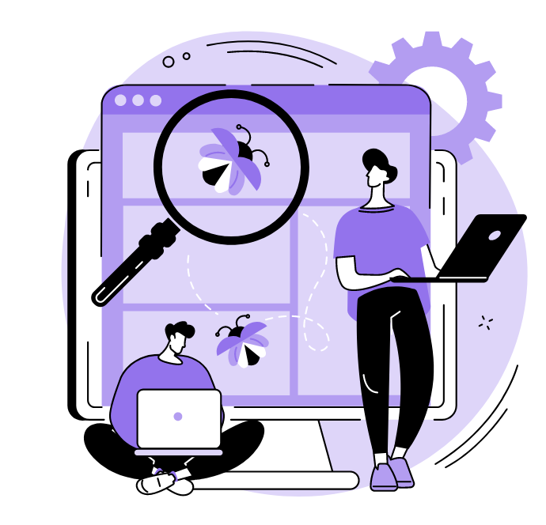
Why software has the bugs?
miscommunication between the team members
Software complexity or a too lengthy software
Too many changing requirements from the clients
Lack of programming skills of a developer
Lack of skilled testers
Lack of collaboration between the team

Slide 6

What is an error?
It is an incorrect human action that produces a false output in an software or an application.
What is bug?
It is the deviation from expected behavior to actual behavior of the system it known as bug.
What is failure?
It is the complete deviation from the actual behavior of the software or the application in a system it is called as a failure.

Slide 7
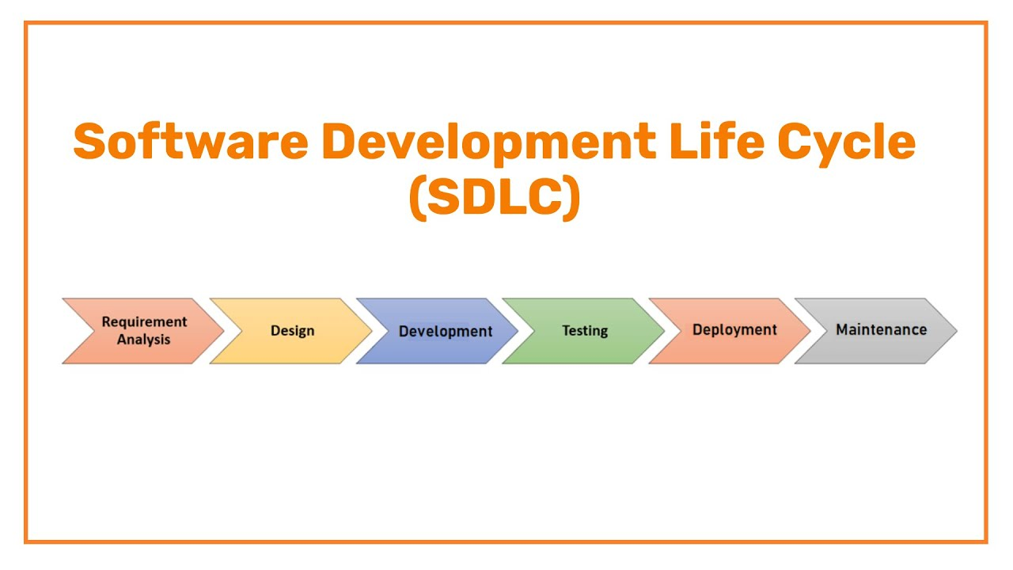
What is SOFTWARE DEVELOPMENT LIFE CYCLE: (SLDC)
It describes the sequence of phases or steps that involved to develop any software from beginning to ending
There are seven major steps involved in the (SDLC)
Planning-Define project scope, feasibility, and resources.
Requirement Analysis - Gather and document software needs.
Design Create system architecture and UI/UX.
Development-Write and implement the code.
Testing-Identify and fix defects through various tests.
Deployment-Release the software for users.
Maintenance-Provide updates, bug fixes, and improvements.

Slide 8
Different Types of SDLC Models
Waterfall Model – A linear and sequential approach where each phase is completed before moving to the next.
Agile Model – An iterative and flexible model with frequent releases and continuous feedback.
V-Model (Validation & Verification Model) – Testing happens parallel to development for early defect detection.
Spiral Model – A risk-driven model combining iterative development with risk assessment.
Iterative Model – Software is developed in small cycles, improving with each iteration.
DevOps Model – Integrates development and operations for continuous integration and deployment (CI/CD)

Slide 9

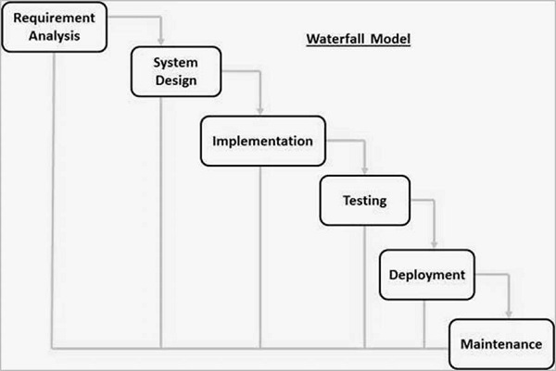
Main Differences Between Waterfall and Agile Model
Waterfall Model
A linear and sequential approach where each phase must be completed before moving to the next.
Best for small projects with well-defined requirements.
Pros: Simple, easy to manage.
Cons: No flexibility; difficult to accommodate changes.

Slide 10
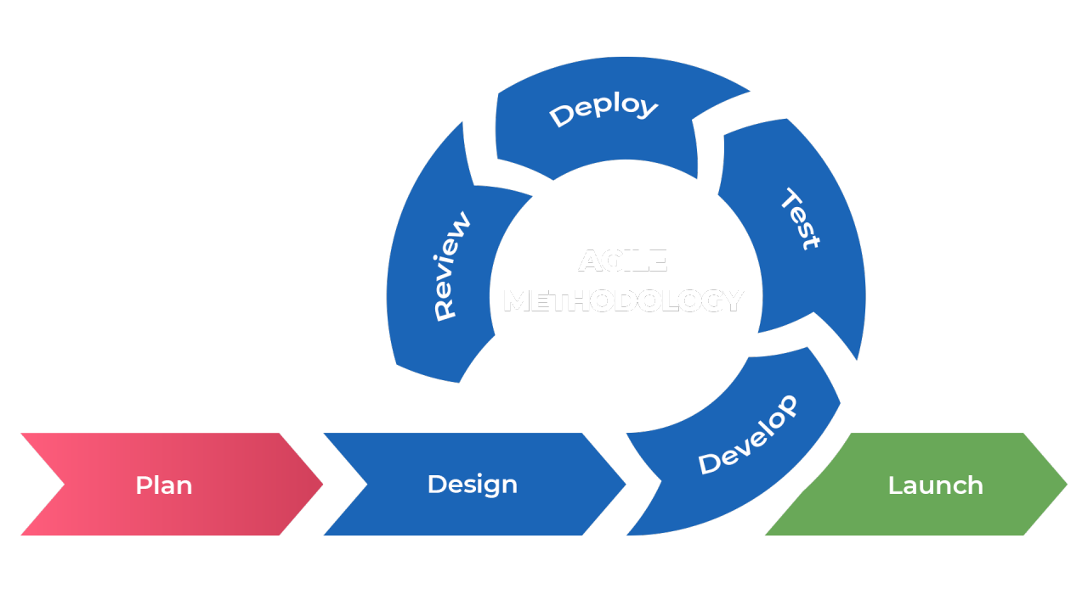
Agile Model
An iterative approach with frequent releases and continuous feedback.
Best for projects requiring flexibility and rapid changes.
Pros: High adaptability, continuous collaboration, customer involvement.
Cons: Requires experienced teams, frequent changes may affect timelines.

Slide 11
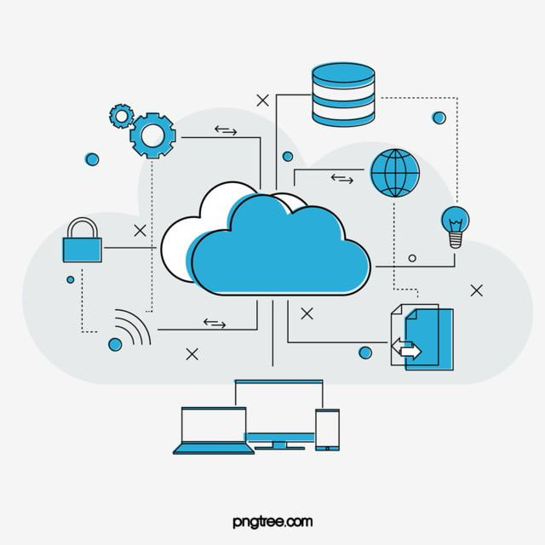
CLOUD
The cloud is a vast online storage space where the people and the businesses store their files and applications, accessible from anywheredata,ith an internet connection.
What is cloud computing?
Cloud computing simply refers to the use of computing services over the internet, including storage, databases, software, and analytics. It is a place where we can store your data and we can also process the data from any where in the world using the internet.
What are the top cloud providers
Amazon Web Services (AWS)-31-32%
Microsoft Azure-20-25%
Google Cloud-12-13%
Alibaba Cloud-4%
Oracle Cloud-3%
Salesforce-3%
IBM Cloud-2%
Tencent Cloud - 2%
Huawei Cloud-2%
Other Providers-

Slide 12
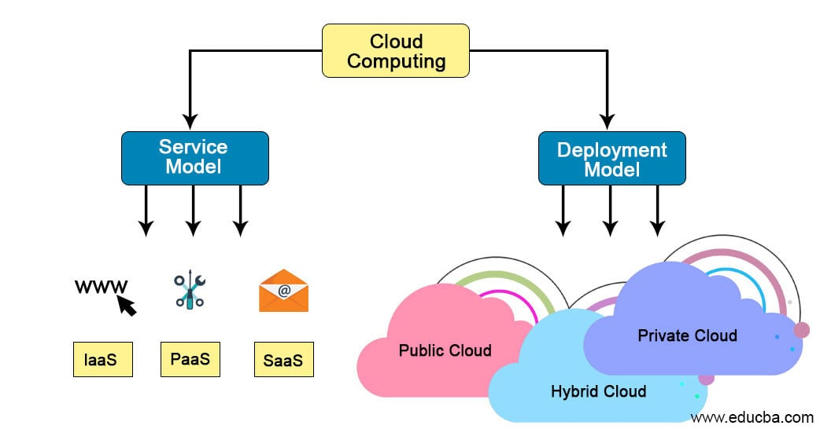
Cloud computing types
There are two types of cloud computing
Deployment model
Service model
In the deployment model there are four types of the cloud
Public cloud
Private cloud
Hybrid cloud
Community cloud
In the service model there are four types
1.SAAS: software as a service
2. IAAS: infrastructure as a service
3. PAAS: platform as a service
4. FAAS: function as a service (serverless computing)

Slide 13
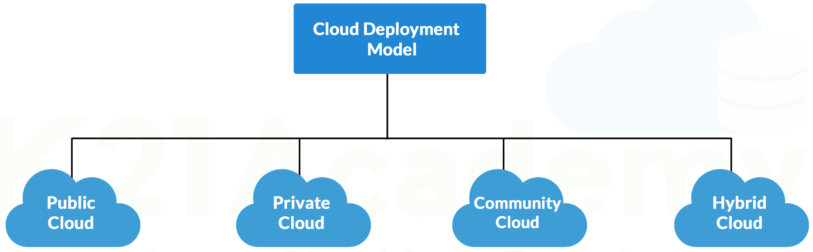
Deployment model
Public cloud : Public clouds provide the resources, such as compute, storage, network, develop-and-deploy environments, and applications over the internet.
Private cloud: the private clouds are built and run and used by an organisation.it offers a hosted servers to limited no of people so it minimizes the security concerns.
Hybrid cloud: it the combination of the both public and the private cloud.
Community cloud: in this two or more organizations use the same cloud platform to store the data to reduce the cost of the storing the data in the cloud.

Slide 14
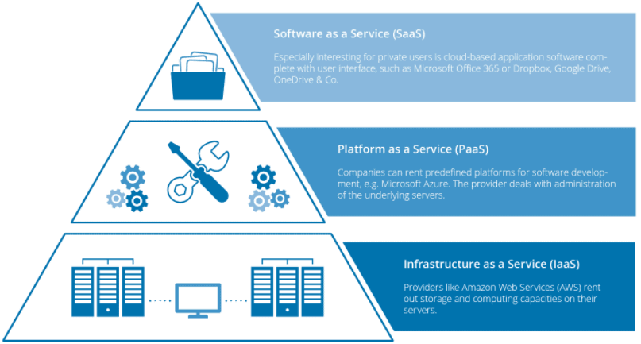
Service model
THE MAIN COMPONENTS IN THE SERVICE MODEL
1.DATA
2.APPLICATION
3. RUN-TIME
4. MIDDLEWARE
5. OPERATING SYSTEM
6. VIRTUALIZATION
7. SERVER
8. STORAGE
9. NETWORK

Slide 15
1. SAAS: software as a serviceSaaS
provides a full application stack as a service that customers can access and use it is like a software application that we can use over the internet this applications are designed for a end user or a customer.
Example: gmail, dropbox, google drive other food delivery apps etc
2. IAAS: infrastructure as a service It provides the virtualized computing resources over the internet.no worries about the underlying the physical machine. Most of the IT admins uses
Example: AWS, microsoft azure google compute engine etc
3. PAAS: platform as a service It delivers and manages hardware and software resources for developing, testing, delivering, and managing cloud applications. It had no control over the underlying architecture
Example : google search engine AWS etc.

